Slide 1

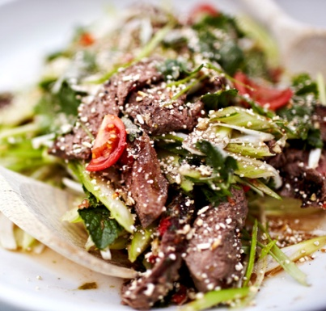

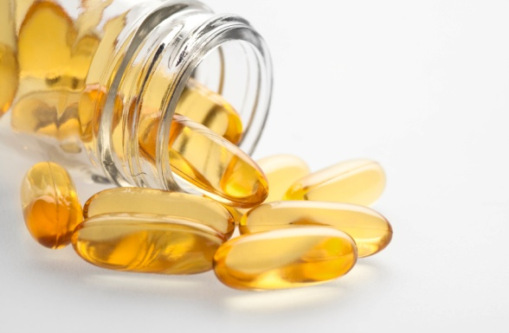
Non-Alcoholic Fatty Liver Disease (NAFLD)
Dr Madunil A Niriella
31.10.16

Slide 2
Definition
Hepatic steatosis
detected either on imaging or histology
In the absence of secondary causes
Alcohol safe use
For males < 14 units per week
For females < 7 units per week
No steatogenic medication use
No chronic viral heaptitis
No hereditary disorder

Slide 3
Disease Spectrum
NAFL (non-alcoholic fatty liver )
fat deposition without inflammation or hepatocellular injury
NASH (non-alcoholic steatohepatitis)
fat deposition with inflammation and hepatocellular injury
Cirrhosis and complications

Slide 4
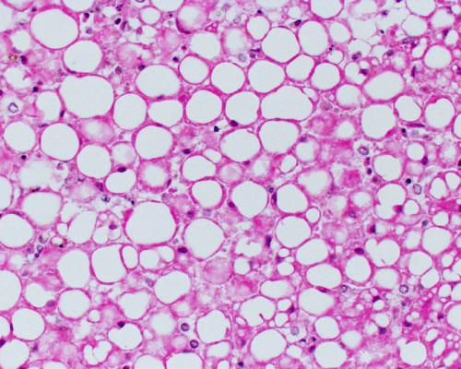
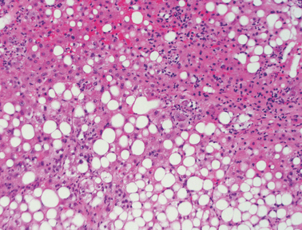
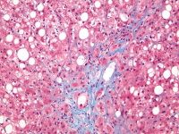
Histology
NAFL (Steatosis) NASH (Steatohepatits) Cirrhosis

Slide 5
Epidemiology
Global prevalence of NAFLD in adults
6 - 33% (depending on the population studied and the assessment methods used)
In Sri Lanka, the community prevalence of ultrasonically detected NAFLD
32.6% in an adult urban population
18% in a rural physically active population
Commonest CLD worldwide

Slide 6
Diagnosis
Histology
Needs liver biopsy
Invasive
Not practical in all patients
Imaging
Ultrasound scan of liver
Simple, Cheap, Non-invasive
Preferred first line investigation
MRI, CT

Slide 7
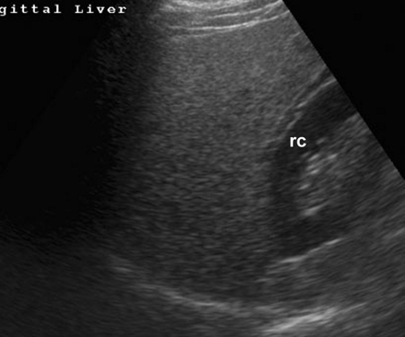
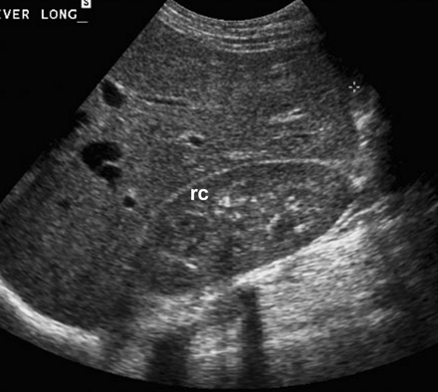
USS features of NAFLD
Fatty liver was diagnosed ultrasonically by the presence of at least two of the following three criteria:
increased echogenecity of liver Vs. kidney and spleen
obliteration of the vascular architecture of liver
deep attenuation of the ultrasonic signal

Slide 8
Metabolic Associations
NAFLD is associated with metabolic risk factors
Obesity
BMI >23 kg/m2, WC >90 cm for males, >80 cm for females
Diabetes mellitus
FPG > 100 mg/dL, HbA1c > 5.7
Dyslipidaemia
Raised TG >150 mg/dL, HDL < 40mg/dL in males and < 50 mg/dL in females
Hypertension
SBP > 135 mmHg, DBP > 85 mmHg

Slide 9
Outcomes of NAFL/NASH

Slide 10
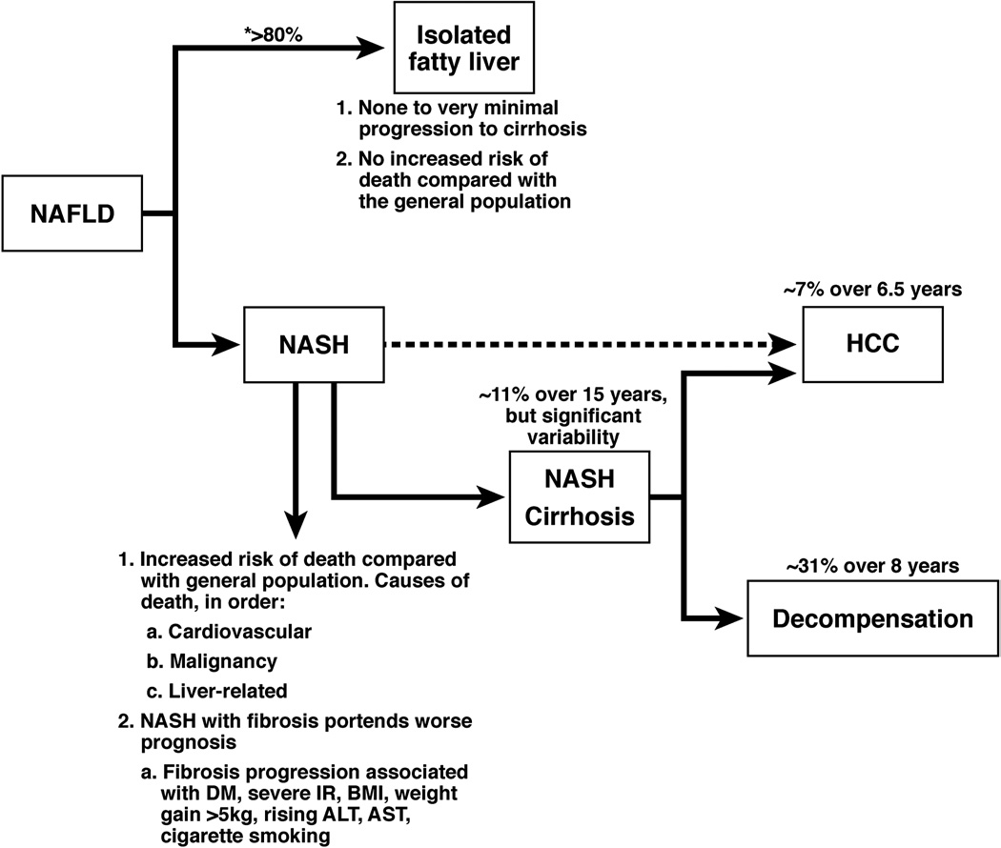
Natural history of NAFLD
Torres DM, Clin Gastro Hepatol 2012

Slide 11
Natural history of NAFLD
Life style modification
Treatment of associated metabolic co-morbidities
Torres DM, Clin Gastro Hepatol 2012

Slide 12
Natural history of NAFLD
Life style modification
Treatment of associated metabolic co-morbidities
+ Liver directed therapies
Torres DM, Clin Gastro Hepatol 2012

Slide 13

“Red flags” for NASH
Age
Gender
HTN
Obesity
Diabetes
ALT and AST level
AST/ALT ratio
Insulin level
PNPLA3
No lab test or imaging study will be able to predict with 100% accuracy
The more risk factors… the more concerned
Accept a lower threshold to biopsy

Slide 14
Liver biopsy for NAFLD
‘High risk patients’
with multiple risk factors for NASH/fibrosis
Secondary cause for fatty liver cannot be excluded
by other tests

Slide 15
Current therapies for NAFLD

Slide 16
Life style modification

Slide 17
Life style modification
Weight loss
Increased physical activity and regular exercise
Healthy eating
Vital in managing all patients with NAFLD (NAFL and NASH ± fibrosis)

Slide 18
Life style modification
Intensive life style changes (vs. education alone)
Dietary advise and regular moderate physical activity (200 min per week)
for 48 weeks
9.3% overall weight reduction
(vs 0.2% controls)
Resulted in improvement
in steatosis and inflammation on biopsy
Promrat K et al. Hepatology 2010

Slide 19
Diet
Optimum diet to treat NAFLD
Not known
Recommendations
Intervention
Calorie restricted diet
600 calories less than daily requirement
Avoid saturated fats, simple carbohydrates and sweetened drinks
Moderate carbohydrate, low fat, low glycaemic index
Emphasis on fruits and vegetables

Slide 20
Diet
Targets
Aim to lose 0.5-1.0 kg/week
Aim to lose >10% body weight and maintain loss
Bring BMI and WC into ethnicity specific ‘normal’ range
BMI < 23 kg/m²
WC<90 cm in males, WC<80 cm in females

Slide 21
Diet
Intensive dietician-led intervention vs. Standard primary care for 12-month
More effective weight loss
5.6 vs 0.6 kg
Achieving remissions of NAFLD
64% vs 20%
≥9% loss of body weight
reduces steatosis, ballooning and hepatic inflammation
Wong VW et al. J Hepatol 2013; Harrison SA et al.Hepatology 2009

Slide 22
Coffee consumption
Dose dependent reduction in consumption of caffeine with increasing severity of steatosis
Caffeinated coffee associated with reduced hepatic fibrosis in NASH
Recommendation
Moderate (2-4 cups) daily unsweetened coffee ingestion reasonable adjunct to therapy for NAFLD patients
Gutierrez-Grobe et al. Ann Hepatol 2012; Molly JW Hepatology 2012

Slide 23
Exercise
Optimal exercise to treat NAFLD not known
Higher levels of habitual physical activity associated with lower levels of steatosis
Improvement in liver fat and in liver enzymes by regular excercise independent of weight loss
Perseghin G et al. Diabetes Care 2007; Thoma C et al. J Hepatol 2012

Slide 24
Exercise
Recommendations
Increase physical activity
Reduce total sedentary time
30 mins moderate exercise 5x/wk
‘Aerobic’, ‘Resistance’, ‘High intensity’ exercise are all effective
Aim for > 10,000 steps/day (pedometer)

Slide 25
Sleep
Comparison of sleep 8.5 vs 5.5 hours each night
Moderate caloric restriction
Lost same amount of weight (~6.6 pounds)
Sleep curtailment
Decreased proportion of weight lost as fat by 55%
Increased loss of fat-free mass by 60%
Recommendation
7-9 hours of sleep each night
Nedeltcheva AV et al. Ann Intern Med 2010

Slide 26
Weight loss
Generally reduces hepatic steatosis
Achieved either by
hypocaloric diet alone or
in conjunction with increased physical activity
Loss of at least 3-5% of body weight
Necessary to improve steatosis
Greater weight loss (up to 10%)
may be needed to improve necro-inflammation

Slide 27
Orlisatat as aid to weight loss
Orlistat
an enteric lipase inhibitor
leads to malabsorption of dietary fat
can aid weight loss in conjunction with LSM
Recommendation
Can be considered in subjects
BMI > 30kg/m² and
who do not achieve target weight by LSM
Continue only if
> 5% loss in 3 months
Not greater than for a year
NICE Clinical guidelines. CG43

Slide 28
Bariatric surgery
Optimum type of bariatric surgery for NASH not known
Cannot be considered as a primary treatment for NASH
Recommendation
Considered as treatment for obesity for patients with
BMI > 40kg/m²
BMI between 35-40kg/m² with co-morbidities likely to improve with weight loss
NICE Clinical guidelines. CG43

Slide 29
Alcohol use
Recommendation
Patients with NAFLD should not consume heavy amounts of alcohol
more than 4 drinks on any day or > 14 drinks per week in men
more than 3 drinks on any day or > 7 drinks per week in women
No recommendation can be made with regards to non-heavy consumption of alcohol by individuals with NAFLD

Slide 30
Liver directed therapies

Slide 31
Liver-directed pharmacotherapy
Recommendation
For patients
with biopsy proven-NASH
where adequate trial of LSM has failed
Consider
Pioglitazone
Vitamin E
Pentoxiphylline

Slide 32
Pioglitazone
Proven benefit of thiazolidinediones in patients with NASH
Both with and without diabetes
12 months treatment with pioglitazone 30mg/day (compared to placebo)
Reduces heaptocelluar injury and fibrosis
PIVENS study
Significantly more patients receiving pioglitazone had resolution of steatohepatitis than with placebo
Aithal GP et al. Gastroenterology 2008; Sanyal AJ et al. NEJM 2010

Slide 33
Pioglitazone
Meta-analysis
Pioglitazone treatment in NASH
Significantly improves hepatic steatosis and inflammation
To a lesser degree fibrosis
Boettcher E et al. Aliment Pharmacol Ther 2012

Slide 34
Pioglitazone
Some concerns about long-term safety
Induces weight gain
Increased risk of CCF, bladder cancer and reduced bone density
Meta-analysis
Patients with T2-DM treated with pioglitazone
Demonstrated 18% reduction in death, MI and stroke
Lincoff AM et al. JAMA 2007

Slide 35
Pioglitazone
Recommendation
After assessing risk and benefit
For patient
with biopsy proven, aggressive NASH
who have failed life style intervention

Slide 36
Vitamin E
PIVENS trial
Beneficial effects on histology in non-diabetics
Significantly more patients had improvement in steatohepatitis (compared with placebo)
Following 96 weeks of vitamin E 800 IU/D
Concerns about long-term effects
Doses > 400 IU/day
Small increase in all cause mortality
Increased haemorrhagic stroke and prostate cancer
Sanyal AJ et al. NEJM 2010; Miller ER 3rd et al. Ann Intern Med 2005

Slide 37
Vitamin E
Recommendation
Vitamin E at daily dose of 800 IU/day
For selected non- diabetic patients
With advanced biopsy proven pre-cirrhotic NASH
Who have failed life style intervention
Not recommended to treat
NASH in diabetic patients
NAFLD without biopsy
NASH or cryptogenic cirrhosis

Slide 38
Pentoxifylline
Meta-analysis
Pentoxifylline 1200 mg daily for 12 months
Significantly reduced the serum ALT and AST
Significantly improved steatosis, lobular inflammation and fibrosis
Significant reduction in BMI and fasting glucose
Recommendation
Promising agent, needs further study to determine ideal subpopulation
Zeng T et al. Eur J Gastroenterol Hepatol 2014

Slide 39
Metformin
Meta-analysis
6-12 months of metformin plus LSM did not improve ALT or liver histology compared with LSM alone
Independent of metformin dose or presence or absence of DM
Recommendation
Metformin has no significant effect on liver histology and is not recommended as specific treatment for liver disease in NASH

Slide 40
Statins
Lack of evidence to show increased risk for serious drug-induced liver injury from use of statins in NAFLD/NASH
There are no RCTs with histological endpoints which investigated statins to treat NASH
Recommendations
Statins can be used safely to treat dyslipidaemia in patients with NAFLD and NASH
Statins should not be used to specifically treat NASH

Slide 41
Miscellaneous agents
Recommendation
UDCA
is not recommended for the treatment of NAFLD or NASH
Omega 3 fatty acids
Premature to recommend for the specific treatment of NAFLD or NASH
May be considered first line agent to treat hypertriglyceridamia in NAFLD

Slide 42
Future therapies

Slide 43
Future Therapies
Obetacholic Acid
GFT505
Lysl oxidase like 2 inhibitor
GR-MD-02 (Galactin 3 inhibitor)

Slide 44
Obetacholic Acid
Semi-synthetic bile acid derivative
FXR agonist
Phase 2b trial (FLINT study)
25mg daily significantly improves histology in NASH
Study stopped early as it met primary end points prematurely
Promising agent awaiting phase 3 trial

Slide 45
Conclusions
NAFLD common
Diagnosed when hepatic steatosis present in absence of secondary cause
USS preferred modality
Liver biopsy in patients likely to have fibrosis and secondary cause not excluded
Associated with the MetS
Associated increase CV risks in addition to liver outcomes

Slide 46
Conclusions
LSM for all patients with NAFLD (NAFL/NASH)
Liver directed therapies for patients with NASH
Weight loss of 9-10% or more improves histologic findings of NASH
Moderate intensity exercise, performing both aerobic and anaerobic (resistance) events, 3-5 times per week is recommended
Exercise coupled with a moderate caloric restricted diet, utilizing low glycemic index foods is optimal

Slide 47
Conclusions
Sleep 7-9 hours per night
Regular coffee consumption may be helpful for NAFLD fibrosis
Vitamin E and Pioglitazone can be considered in the right patient population
Future therapies are in development and show promise but are still not ready for prime time

Slide 48


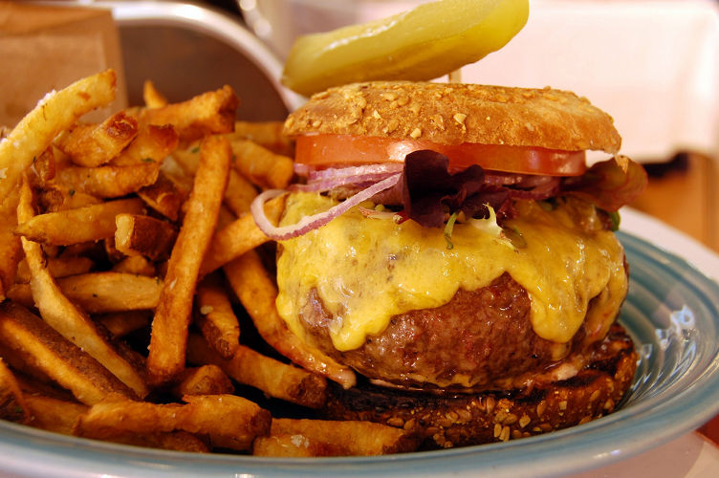


Slide 49

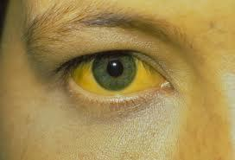
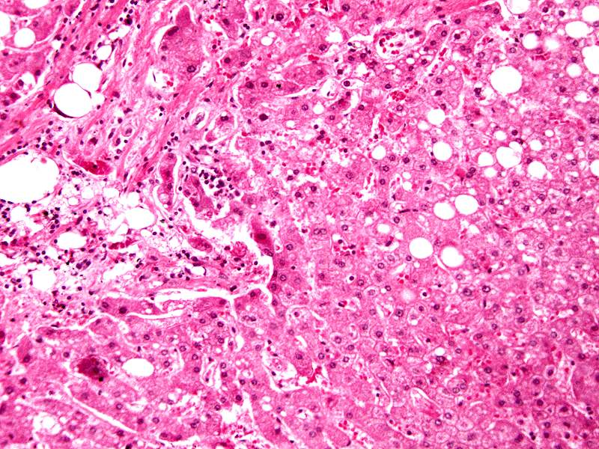
Alcoholic Liver disease (ALD)
Dr Madunil A Niriella
12.05.15

Slide 50
Spectrum of disease
AFLD (Alcoholic fatty liver disease)
Occurs in 90% of heavy drinkers
Reversible through abstinence
AH (alcoholic hepatitis)
10-30% of alcohol abusers
Mild to severe life threatening
High short term mortality
Alcoholic cirrhosis and complications
Develops in 8-20% of heavy drinkers
Risk factor for HCC

Slide 51
Histology
AFL (Steatosis) AH (Alcoholic hepatits) Cirrhosis

Slide 52
Risk factors
Unsafe alcohol intake
Males > 14 units per week
Females > 7 units per week
Duration of intake
Females (vs. Males) develops ALD after
Shorter duration
Lower daily intake
Polymorphisms of genes involved in alcohol metabolism

Slide 53
AH diagnosis
History
Anorexia, nausea, vomiting
Jaundice, fever, abdominal pain
Screen for alcohol abuse
CAGE
Examination
Icterus
Tender hepatomegaly +/- bruit
Ascites
HE

Slide 54
AH diagnosis
Investigations
Raised WCC – N > 7700 cell per cu mm
Raised AST > ALT (2:1), level <300
Raised S bilirubin - > 5mg /dL
Raised INR
Low albumin
Raised serum IgA
USS – “hepatitis” +/- CLD

Slide 55
Treatment
Abstinence
Survival benefit even if CLD present
Counseling
Baclofen to help maintain abstinence
5mg TDS for 3 days -> 10mg TDS 12 weesk
Nutritional support
Calories
Vitamins – folate, thiamine, B6
Micronutrients – Zc, Cu, Mg

Slide 56
Treatment
Anti-inflammatory drugs
Glucocorticoids
Short term survival benefit up to 1 year
In severe cases DF* > 32 or those with HE
In absence of active sepsis
Prednisolone 40mg daily for 4 weeks -> 20mg daily for 1 week -> 10mg daily for 1 week
Pentoxyphylline
400mg TDS for 6 weeks
Reduces death due to HRS
*The Maddrey discriminant function (DF) [4.6 × (prothrombin time (PT) in seconds - control PT) + serum bilirubin (mg/dL)]

Slide 57
Thank you

